Slide 1
template-based stereo odometry
Alankar Kotwal
Indian Institute of Technology Bombay
alankarkotwal13@gmail.com

Slide 2
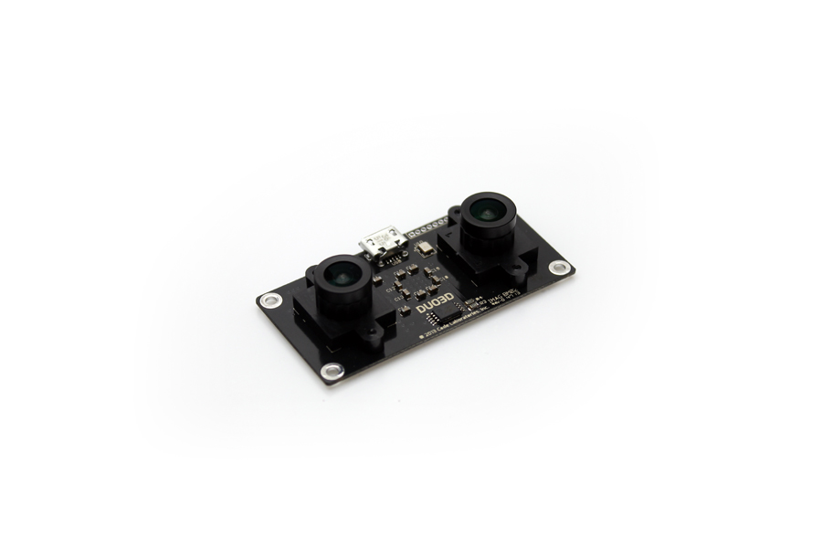
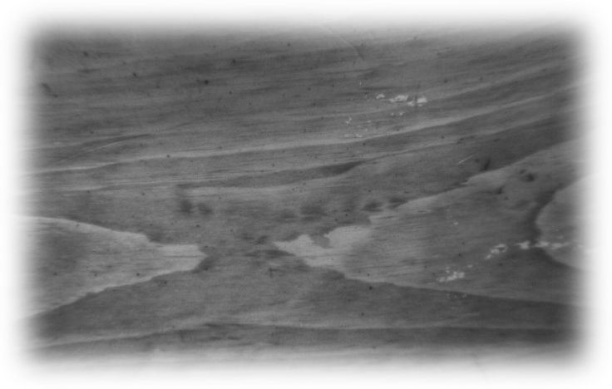
defining the problem
with the stereo camera
facing the floor
figure out how the
camera moved
wrt the floor

Slide 3
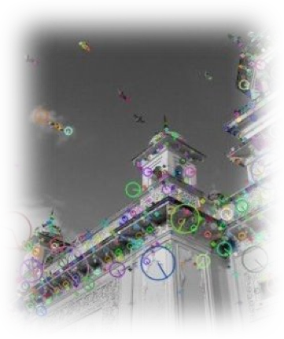
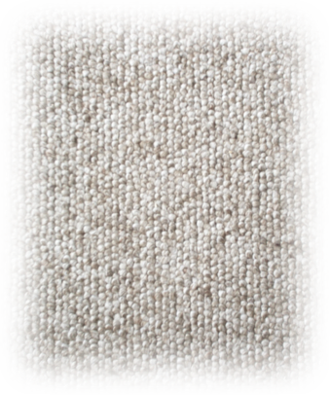
why is this difficult?
unique feature points (corners)
in normal images
no corners or too much
self-similarity => false matches!

Slide 4
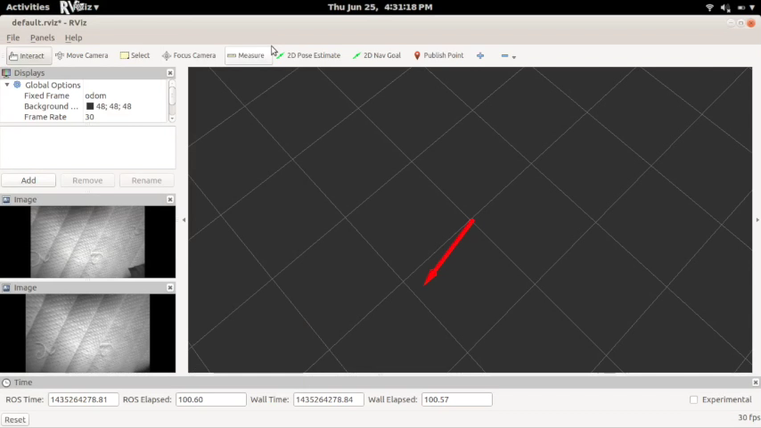

Slide 5
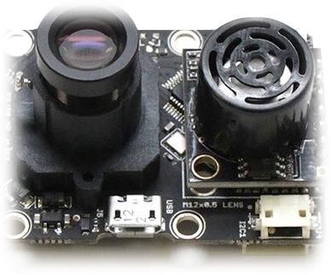

why stereo?
sense of scale absent
in monocular systems
=> need to use ultrasonics /
other rangefinders
better to track two images?
possibilities of getting
more information?
narrow field of view

Slide 6
can we make a better ;) replacement?

Slide 7
clearly, we can’t use feature points

Slide 8
which means we need to use direct matching
SSD / SAD / Normalised Cross-Correlation

Slide 9

general workflow
get stereo depth
(maybe roll, pitch?)
get stereo disparity
convert flow to physical
displacement and
rotation
get frame-to-frame
optical flow

Slide 10
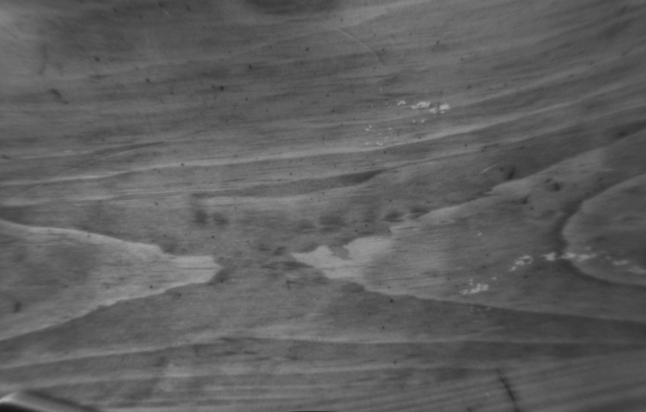
(rectified) stereo disparity
assumption: plane nearly
parallel to camera planes
assumption: camera pose
doesn’t change
much between frames
displacement only in this direction

Slide 11
estimate disparity by measuring translations!
translations by maximising NCC, here

Slide 12
why not regular stereo-matching?
big correlation window size => slow, bad results

Slide 13
disparity -> depth
known camera parameters

Slide 14
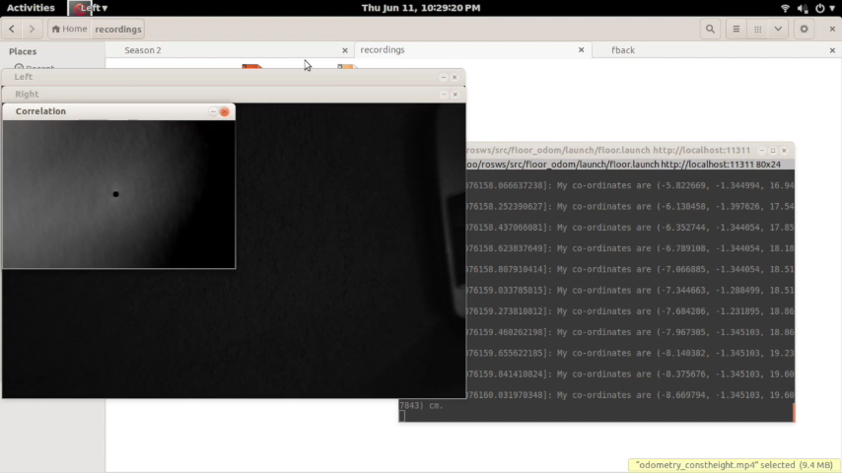

Slide 15
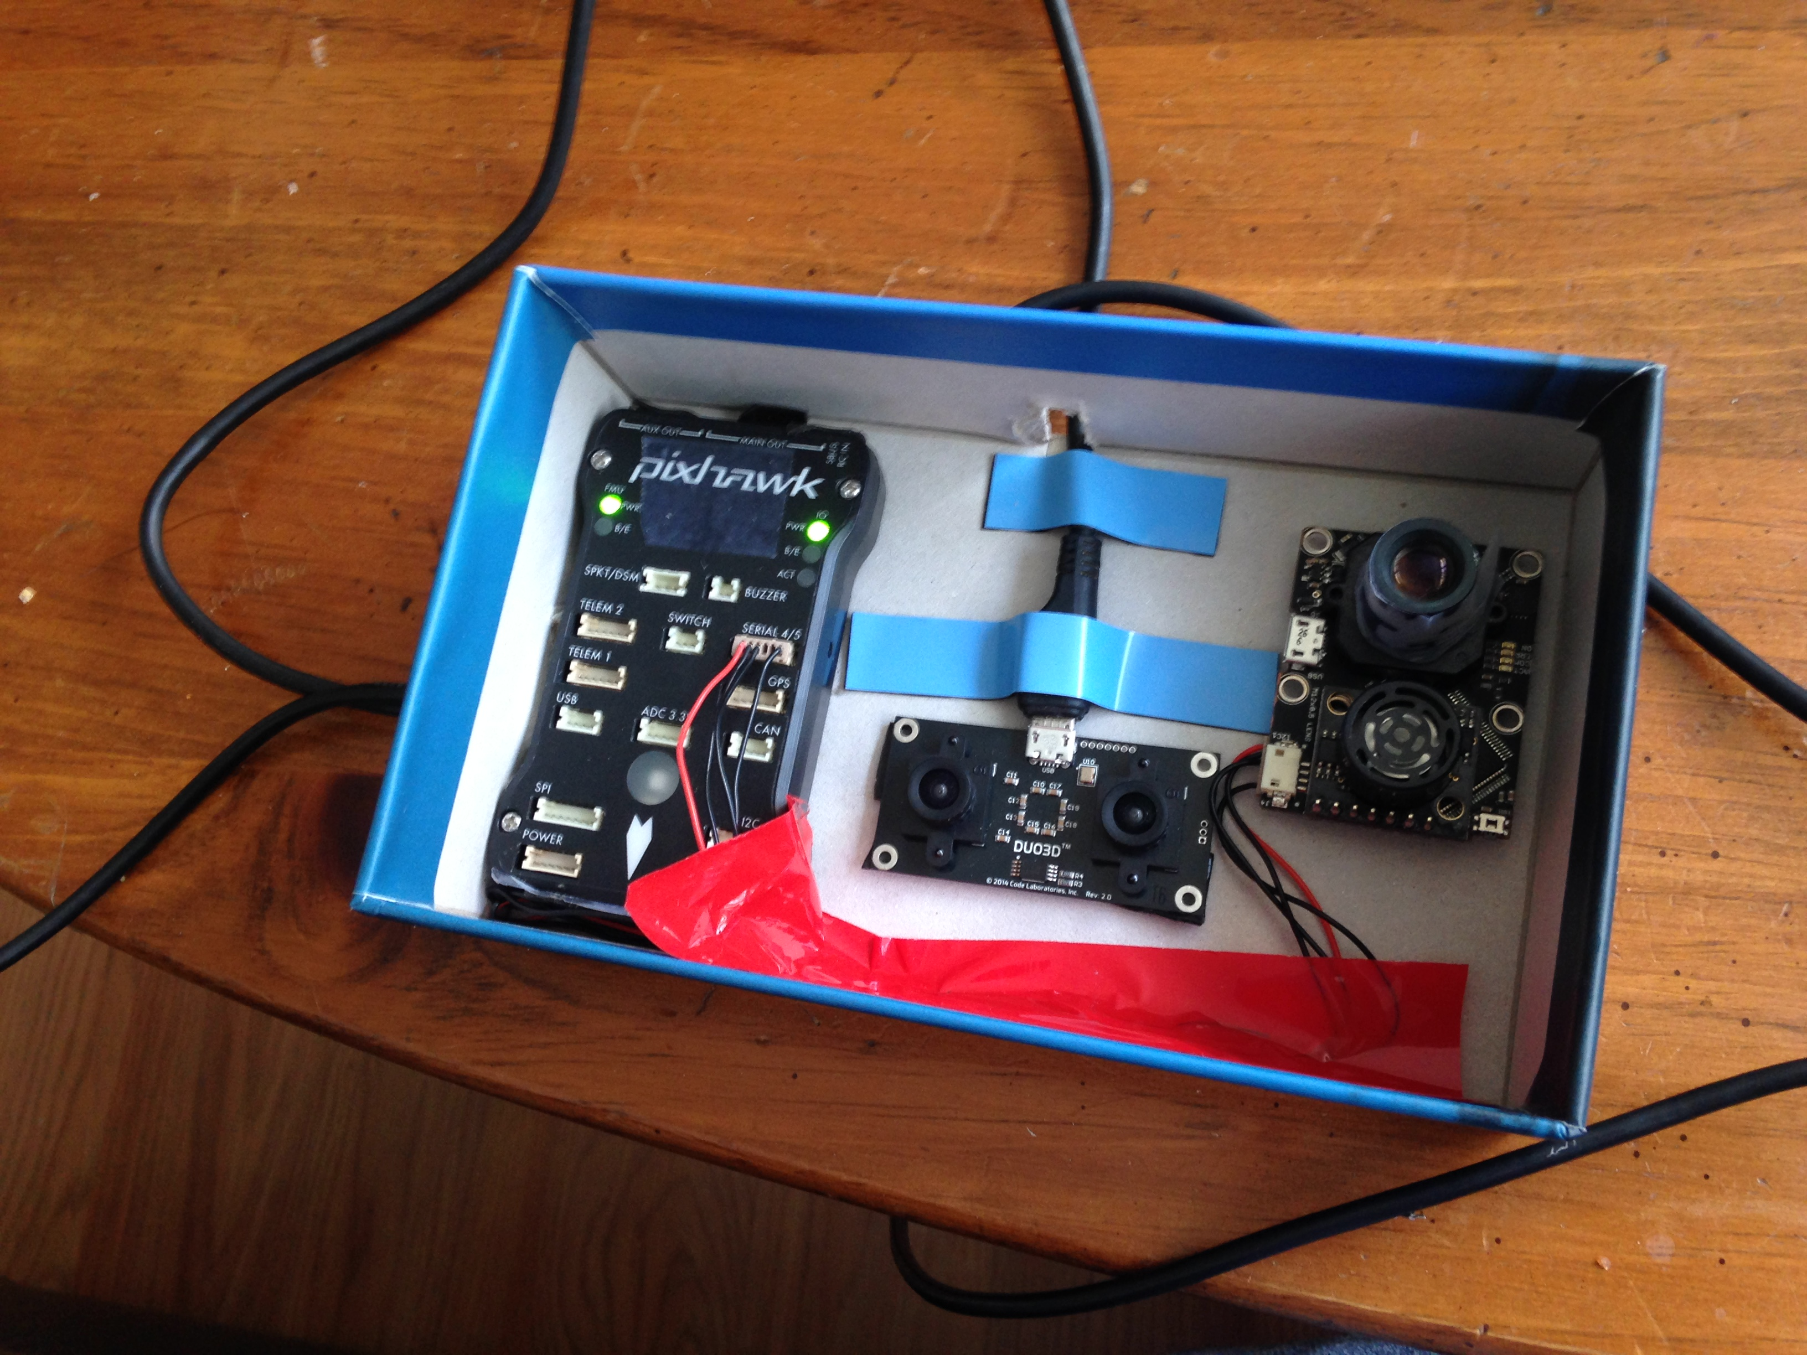

Slide 16
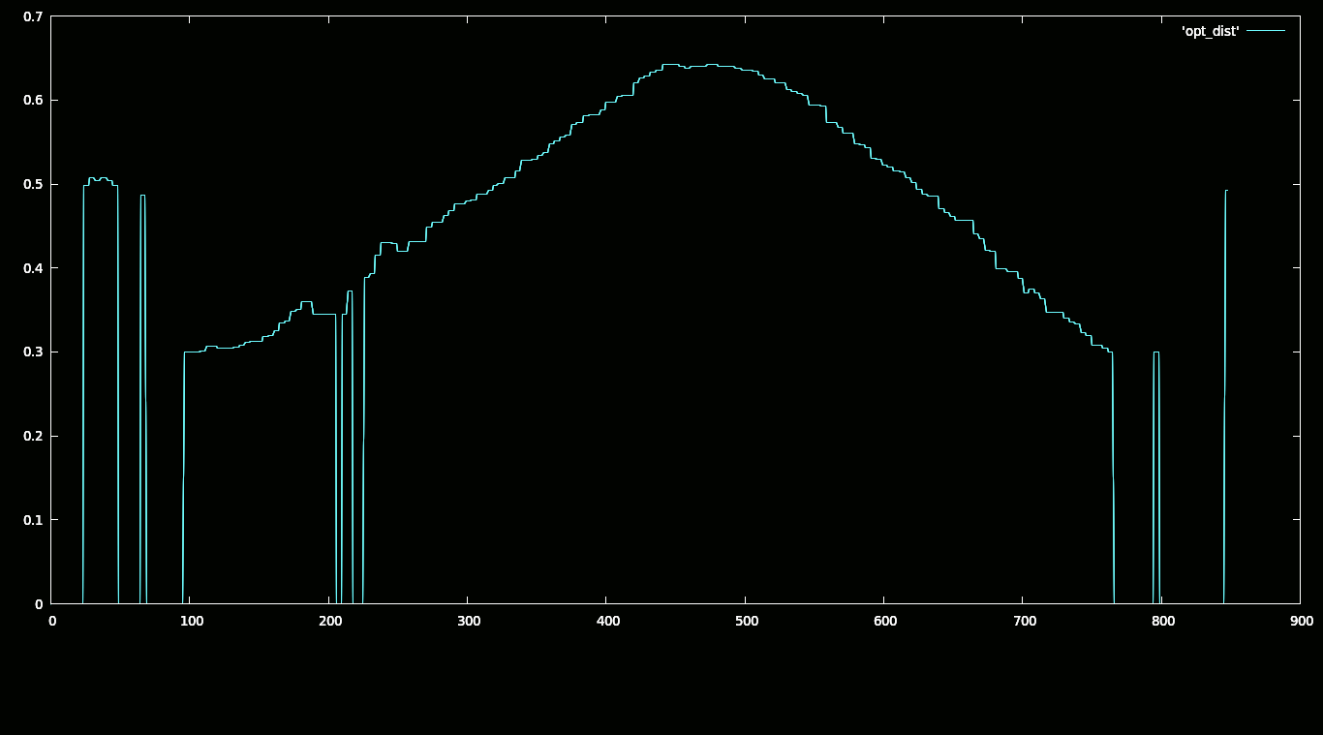
PX4FLOW

Slide 17
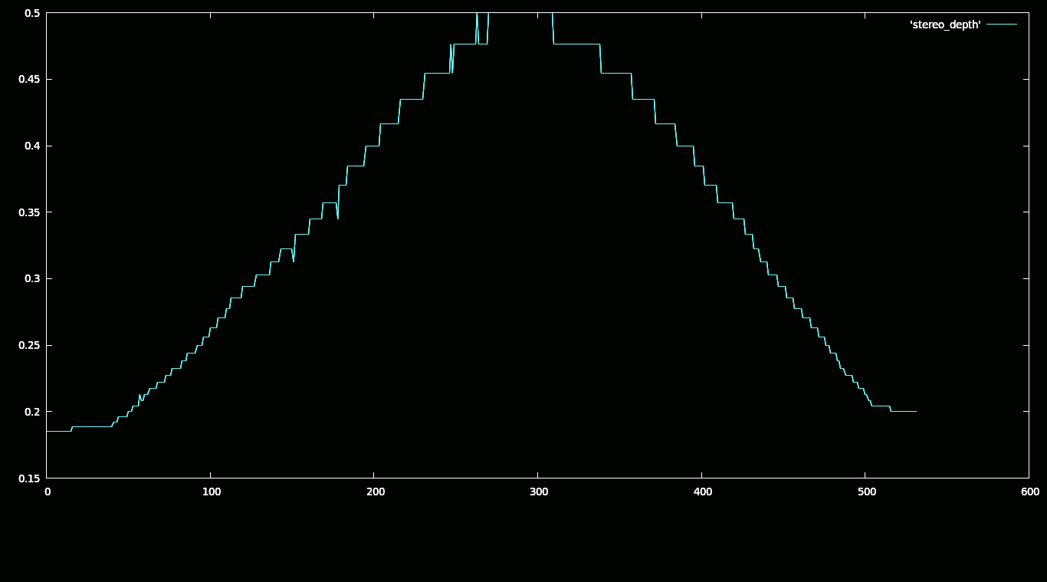
DUO3D

Slide 18
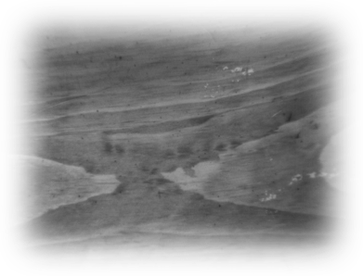
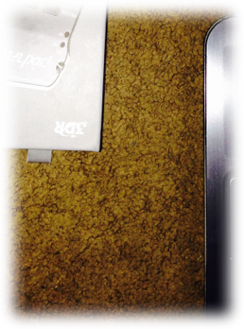
outliers and angles?
planar assumption => looking
only at the floor!
non-planar case is hard!
which areas to track?
camera tilted? some ideas later

Slide 19
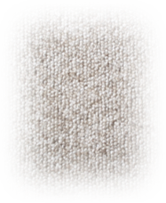
position tracking
considering our almost-level assumption,
scale, rotation and translation

Slide 20
s-r-t tracking: try 1
scale from depths for
this and initial frame
rescale initial frame to
fit current frame
try to get rotation by
maximizing NCC for
rotated template
assume rotation isn’t
much, get translation
(NCC as in stereo!)

Slide 21
results
without rotation, good estimates of 3-d coordinates

Slide 22

s-r-t tracking: try 2
gradient-descent
s-r-t tracker
vpTemplateTracker class
to track images across time
vpTemplateTrackerWarpSRT
ViSP

Slide 23
more results
excellent estimates of 3-d coordinates and yaw!
see ahead..

Slide 24
making this robust

Slide 25

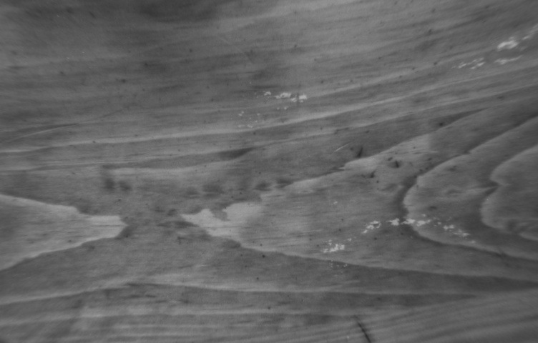
depth: block matching
run outlier rejection to get robust displacement

Slide 26
but this gives us more!
what if we fit a model to the depth variation?

Slide 27
RANSAC plane-fitting
get depths by block
matching
get world coordinates
of block centers
fit plane using outlier
rejection
get roll, pitch!

Slide 28
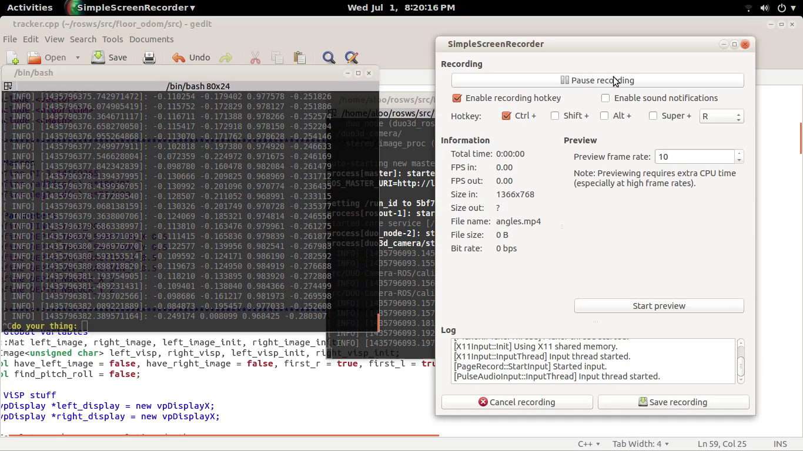

Slide 29
we have 6-DoF!
and, this takes care of the slightly non-planar case

Slide 30
of course, conditions apply
sufficient lighting, texture for the difference measure
unreliable at the moment

Slide 31

ROS implementation details
master
parameters
parameters
/tracker/
x
y
tracker_z
stereo_z
yaw
roll
pitch
stereo driver
tracker
image_rect
CameraInfo

Slide 32
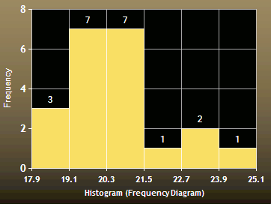
data fidelity
histogram of recorded displacements over 20 cm length
wooden table-top

Slide 33
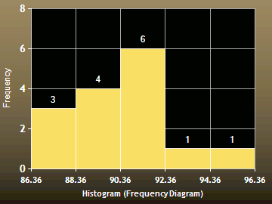
data fidelity
histogram of recorded yaws over 90 deg
wooden table-top

Slide 34
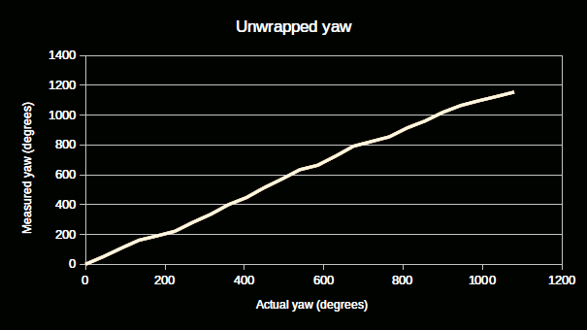
data fidelity
typical unwrapped yaw over five rotations
wooden floor

Slide 35
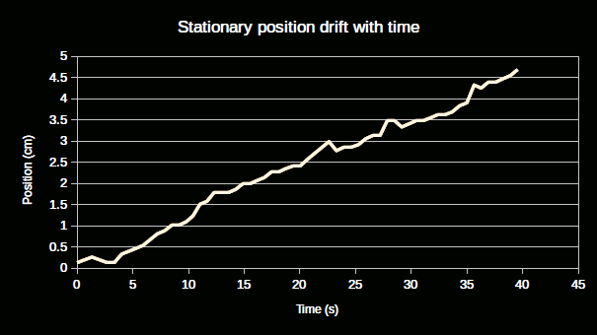
drifts
RMS
drift
typical stationary position drift, at 50cm, wooden table-top

Slide 36
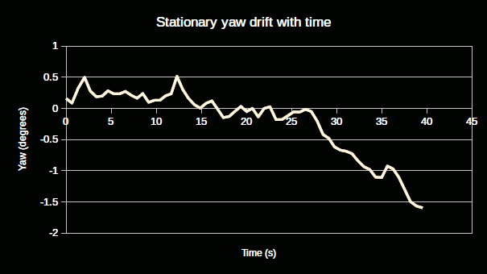
drifts
RMS
drift
typical stationary yaw drift, at 50 cm, wooden table-top

Slide 37

stress-tests on depth, 1s
~ 1 m
use ultrasonics for
better heights?
~ 5 cm, with enough light

Slide 38
stress-tests on speed
resolution | max x-speed | max angular speed
1x | ~ 0.18 m/s | ~ 10 deg/s
0.5x | ~ 0.3 m/s | ~ 15 deg/s
0.3x | ~ 0.4 m/s | ~ 15 deg/s
0.25x | ~ 0.4 m/s | ~ 20 deg/s
approximate best values, wood floor

Slide 39
notes
works best on textured surfaces
white tiles are bad!
good lighting a must!
specularities are BAD!
honour speed limits!
as of now, camera needs to be nearly horizontal

Slide 40

long-range test: corridor
textured carpet
height 20-50 cm
5 m
position drift over loop ~ 30 cm
yaw drift over loop ~ 30 deg
75 m
*if you do this slow enough and follow all conditions above*

Slide 41
advantages over PX4FLOW?

Slide 42
better depth estimates
as in the graph, lower depths and more reliability

Slide 43
(potentially) better maximum camera speeds
better field of view, see ahead..

Slide 44
PX4FLOW vs DUO: speed
PX4FLOW max ground
speed ~ 0.25 m/s
tested at
~ 0.3 - 0.4 m/s
max vertical speed
~ 0.1 m/s
no limits
(absolute measurement)
?
rotation speed ~ 10 deg/s
ref.: http://diydrones.com/profiles/blogs/px4flow-microquad-adventure

Slide 45
no dependence on external hardware
no gyro needed, unlike PX4FLOW

Slide 46
disadvantages

Slide 47
slow processing, @
~ 3Hz
mostly because of depth-determination
better tracking algorithm? see ahead..

Slide 48
override: downsampling
almost as reliable results with 0.5, four times faster!
(greater drifts, of course)

Slide 49
other things tried
which didn’t go as well ;)

Slide 50
affine / projective transforms for depth
unreliable homography fits, slow affine fits
problems due to inadequate rectification

Slide 51
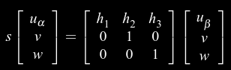
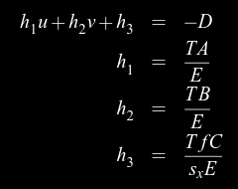
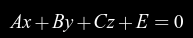
homographs for depth
rectified images =>
=>
ref.: http://web.eecs.umich.edu/~jjcorso/pubs/jcorsoreport2002.pdf

Slide 52
affine homographs
approximate homography by affine transform?

Slide 53
we could use the above for position too!

Slide 54
what I didn’t do
(but would like to)

Slide 55
making position estimation robust
similar block-matching with an s-r-t warp
RANSAC-based filtering

Slide 56
keyframes
to eliminate long-term drift

Slide 57
hardware acceleration
to allow greater frame-rates, speeds

Slide 58
the badly non-planar case
identify 'connected' regions by edge detection
and then track them individually?

Slide 59
fusing depth data
from the position tracker, stereo and ultrasonics
(tracker good at high freq, others good at low freq)

Slide 60
thank you

